Slide 1

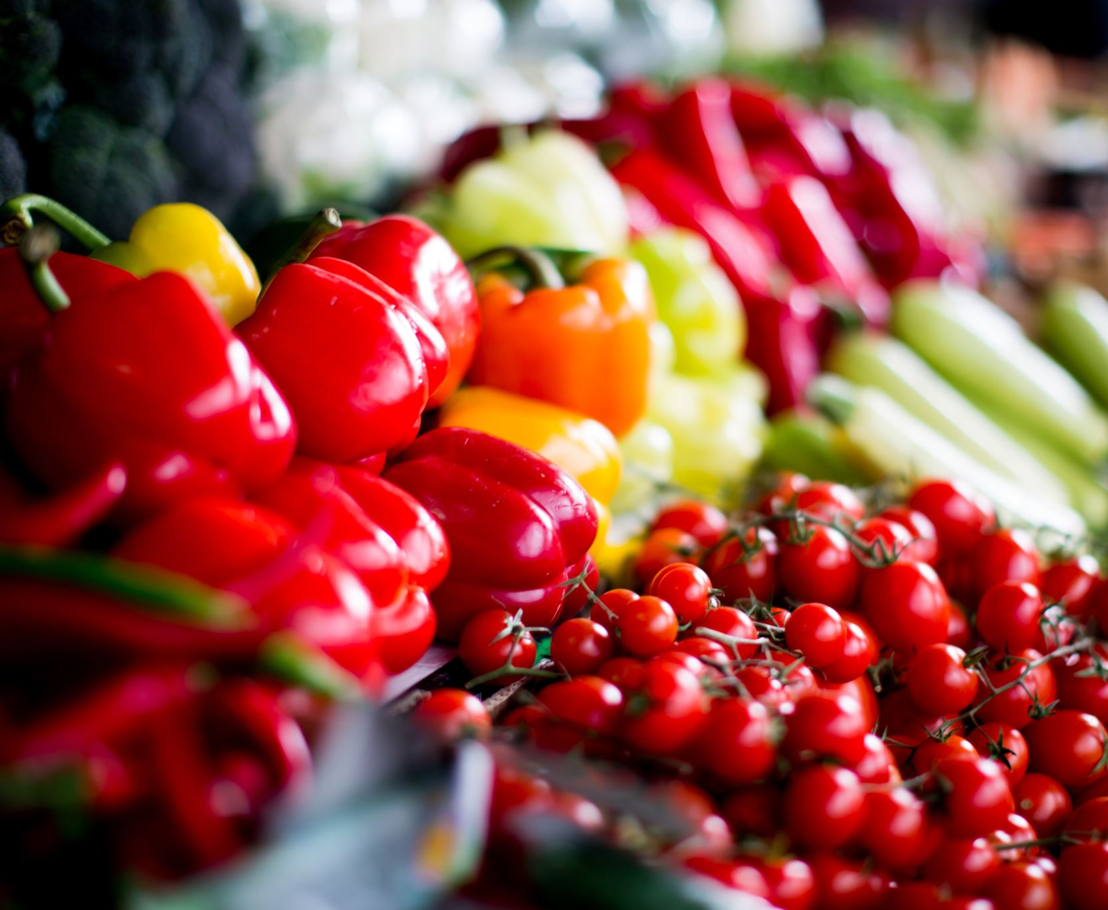
GROCERY LISTING APP
batch 85
TEAM 4
Dhamotharan k
Divya B
Suvetha S
pADMARAJU
Neeraj Kumar

Slide 2
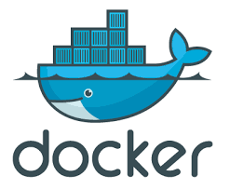

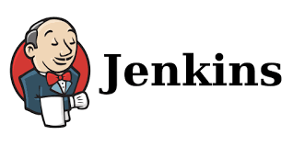

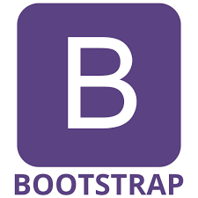

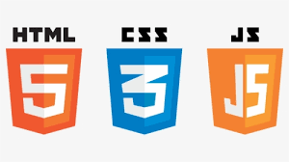
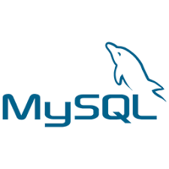
Technologies used

Slide 3
Admin Operations
Add a Product
Delete a Product
Update a Product
View a Product

Slide 4
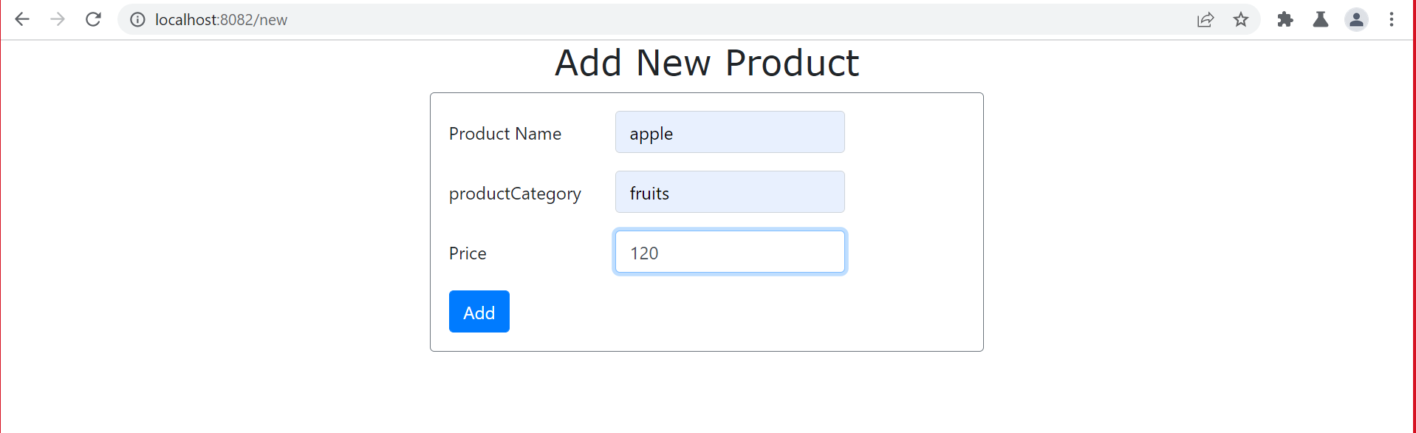
ADD PRODUCT

Slide 5
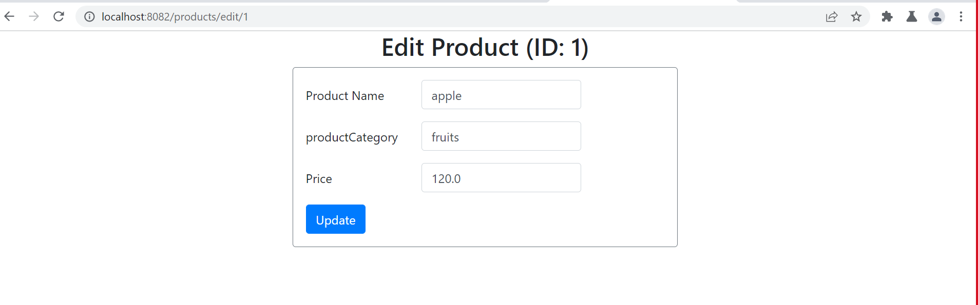
Update Product

Slide 6
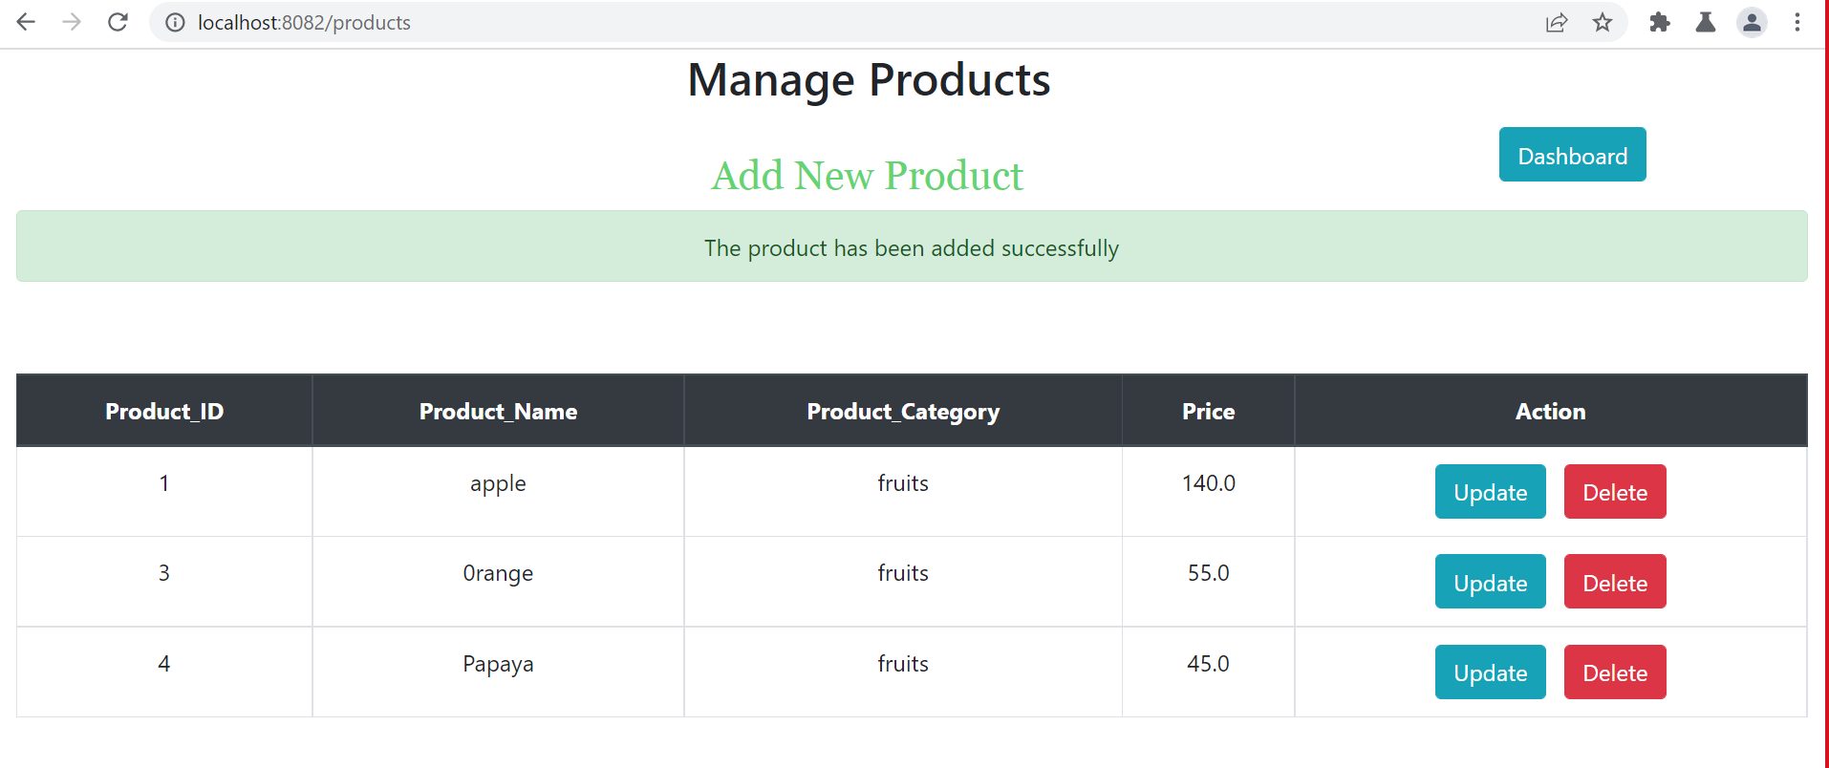
View Product

Slide 7
User Operations
Sign In / Sign Up
Categories
View Products and add to cart
Payment Method
End

Slide 8
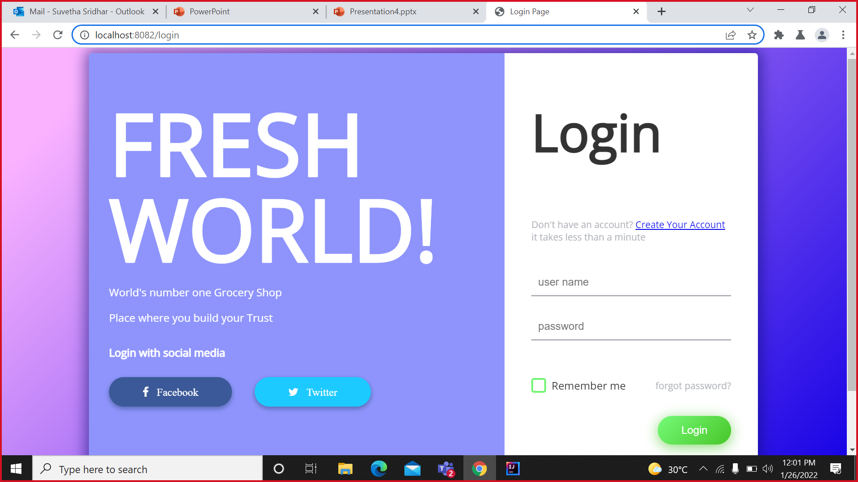
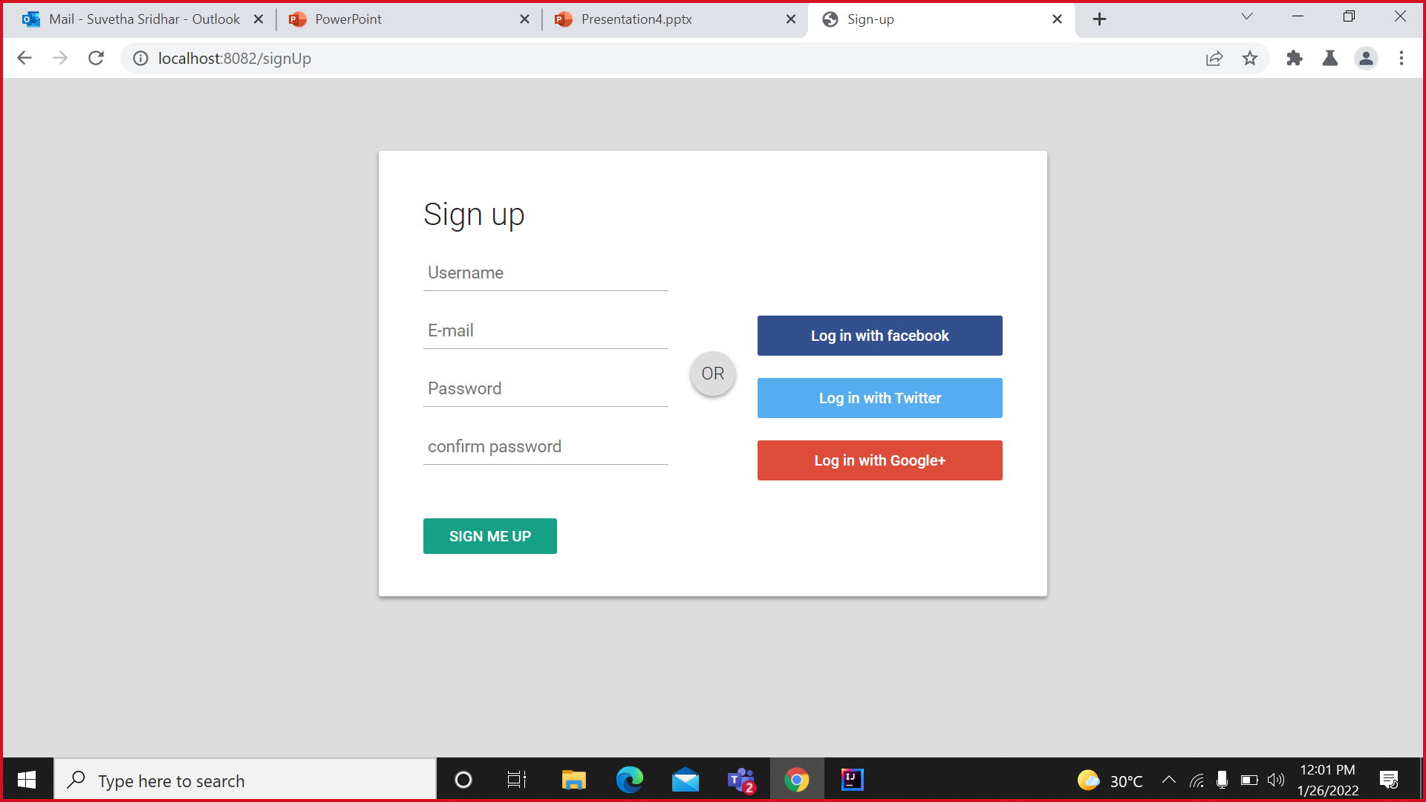
Sign In/Sign Up

Slide 9
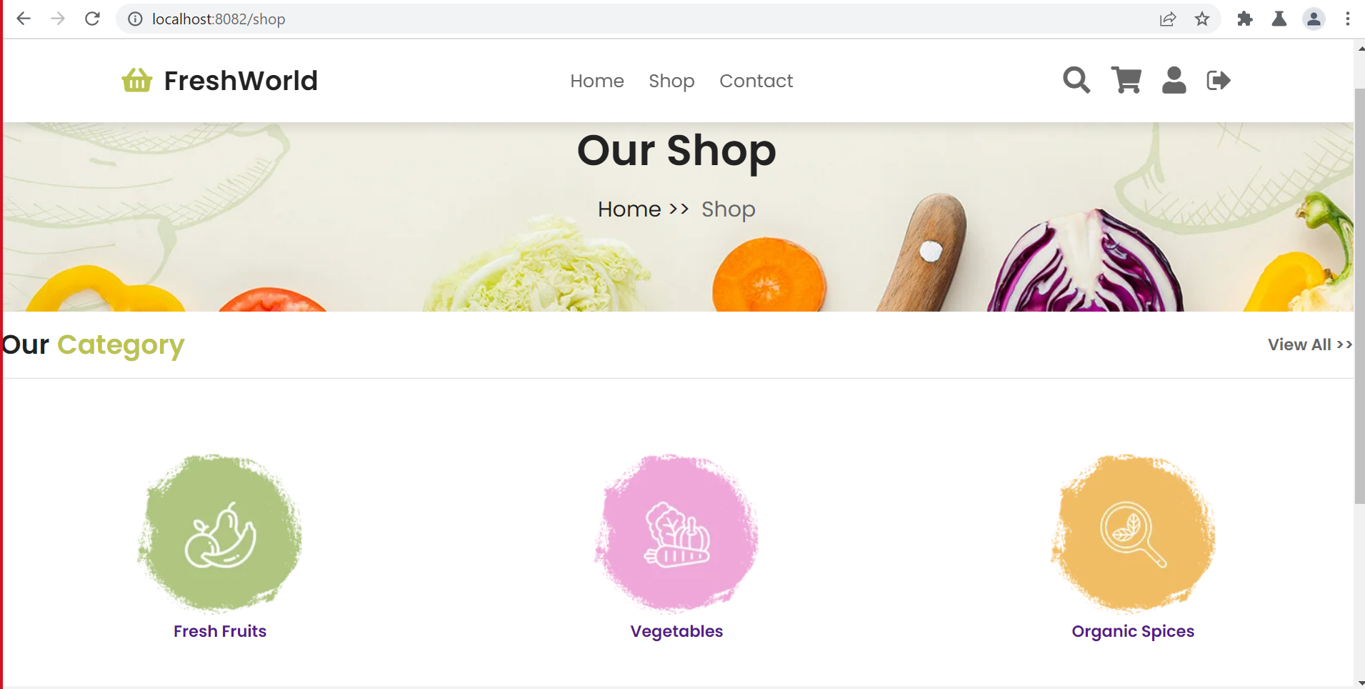
Categories

Slide 10
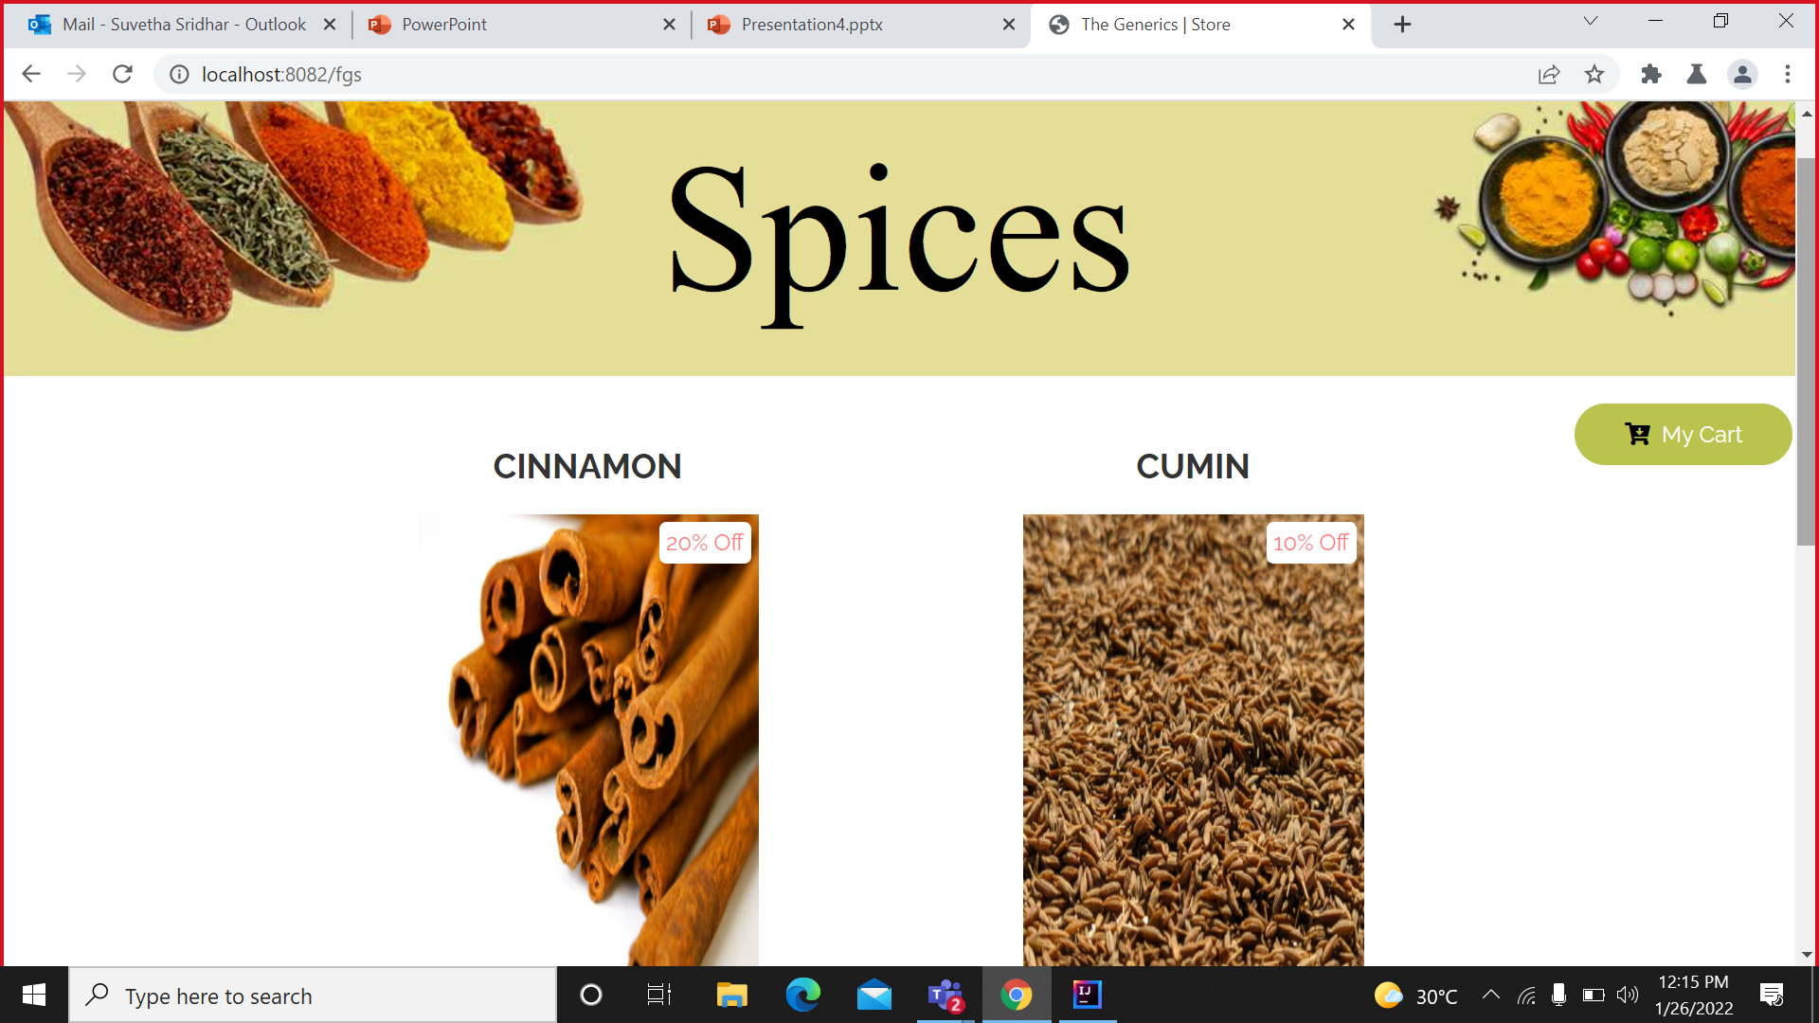
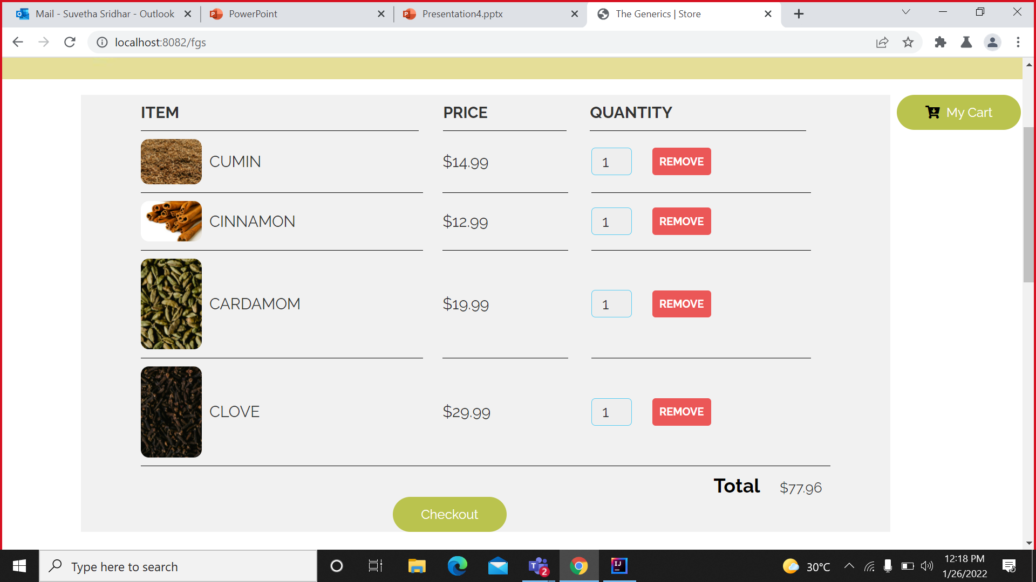
Products

Slide 11
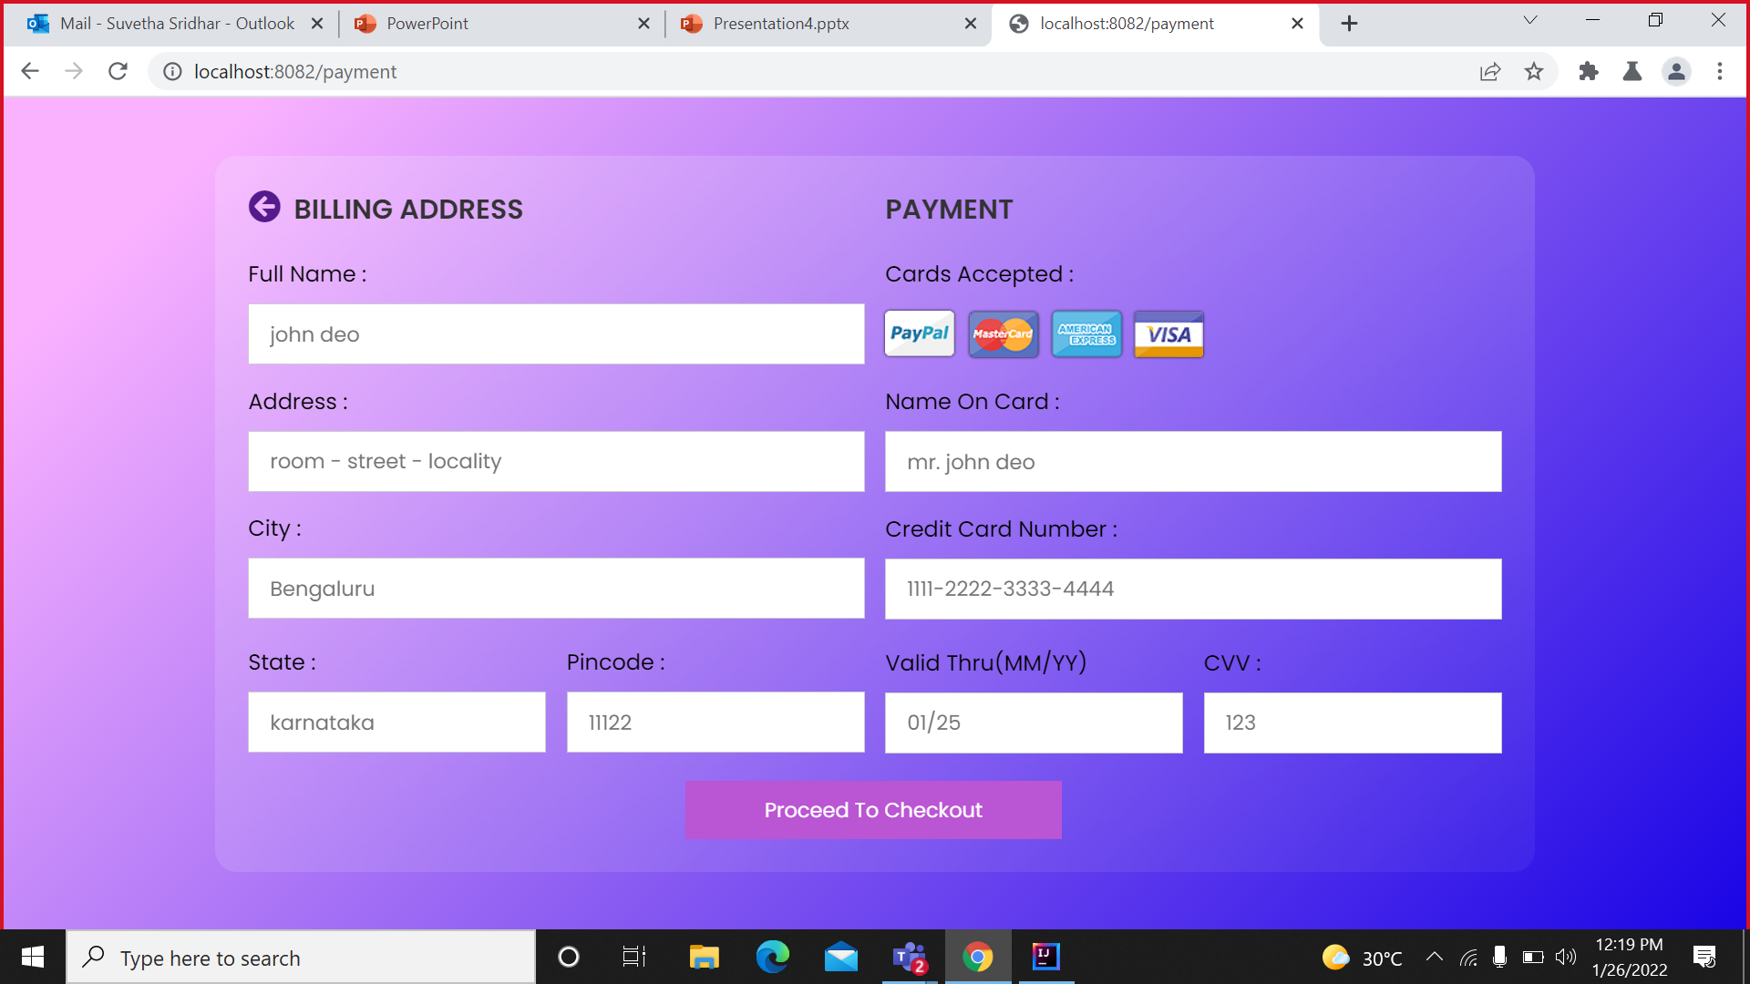
Payment

Slide 12
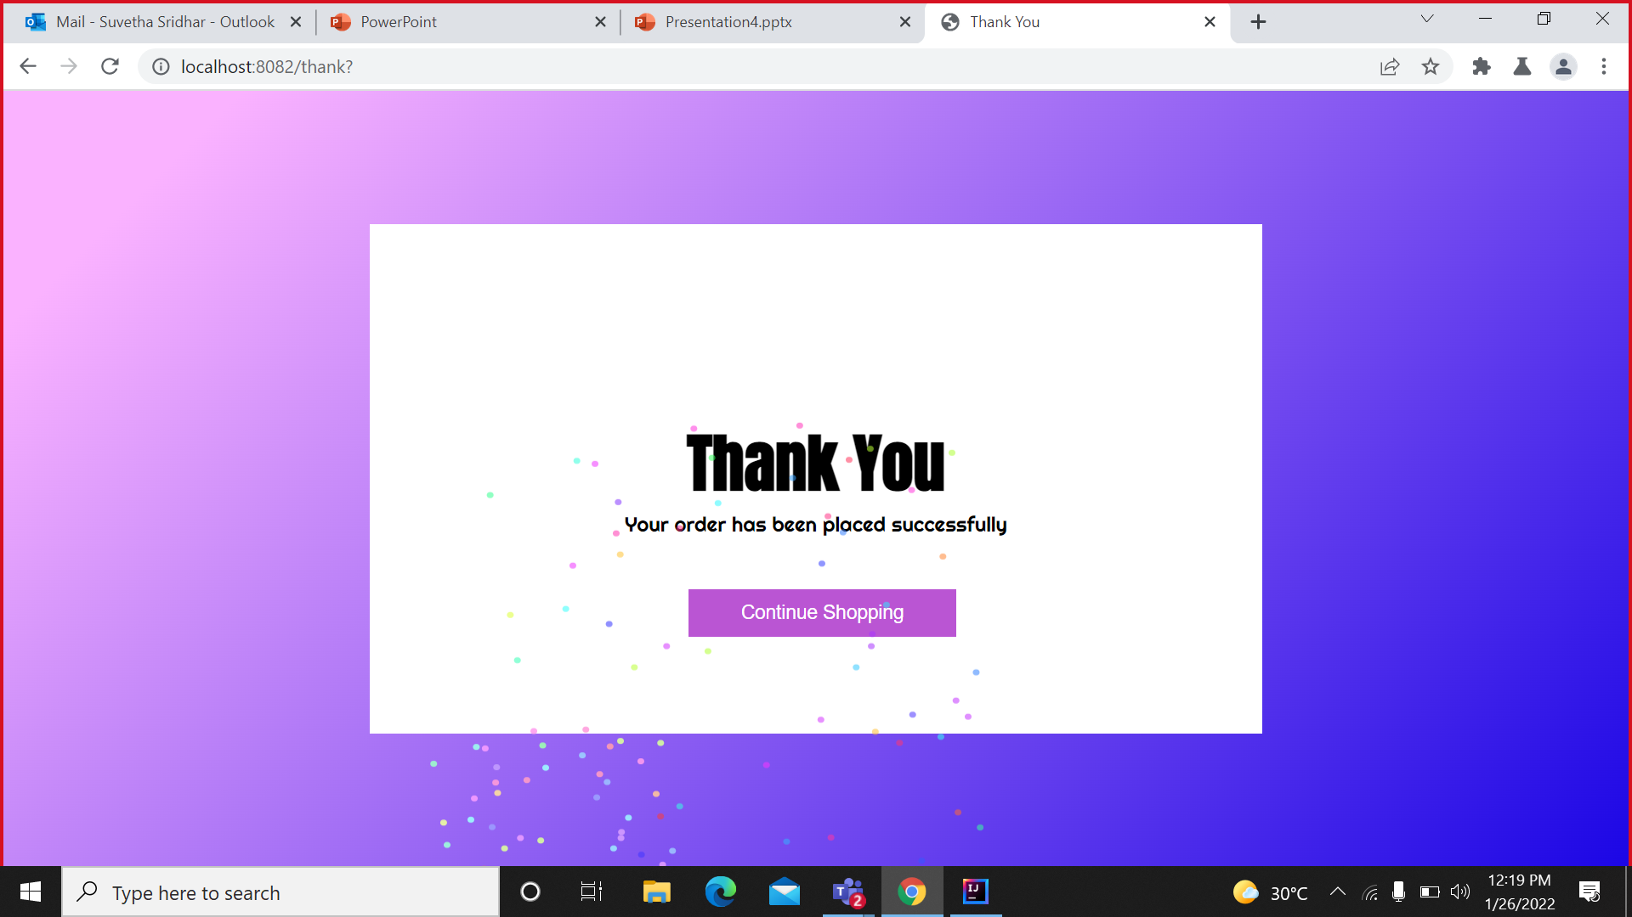
End

Slide 13
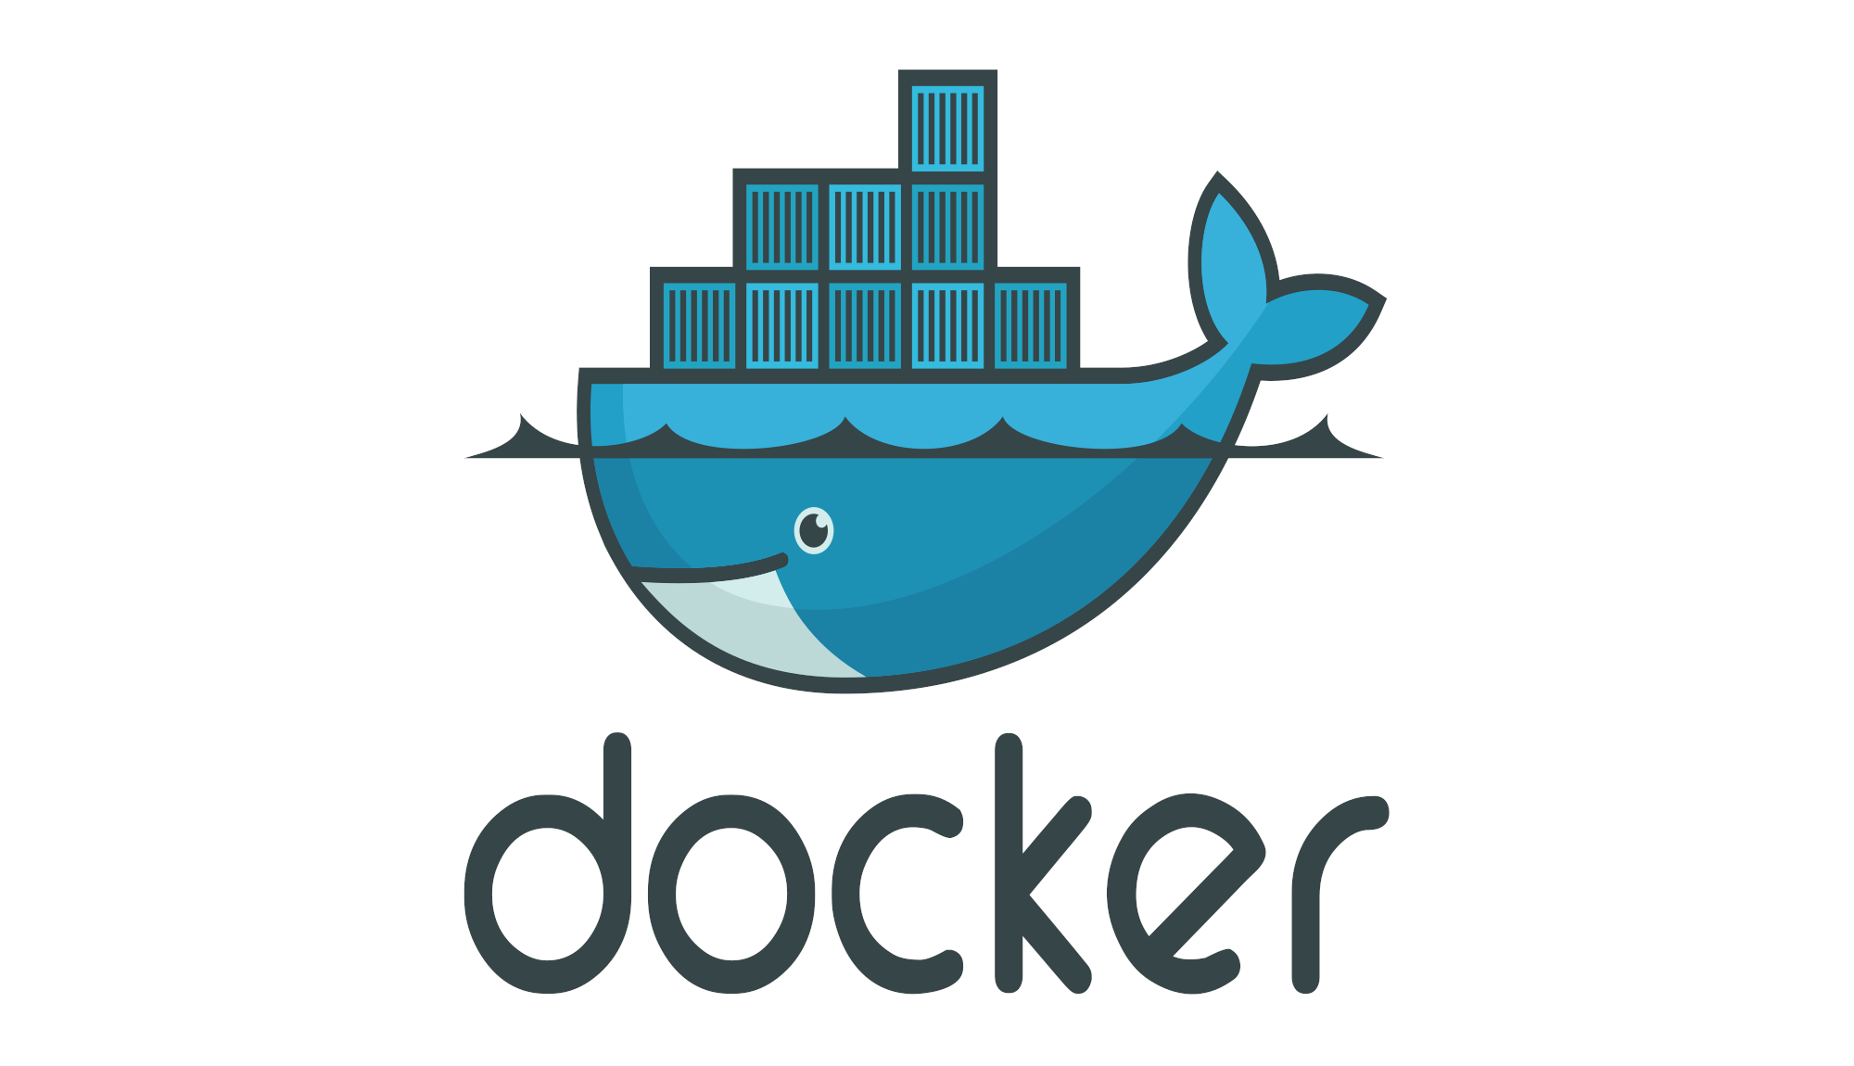
Docker
Docker is a containerization platform that packages the application and its dependencies together inside a container.
It is a tool designed to make it easier to create, deploy, and run applications by using containers

Slide 14
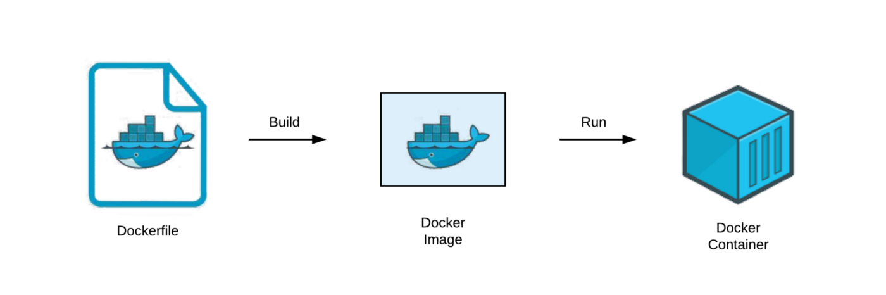
DOCKER PROCESS

Slide 15
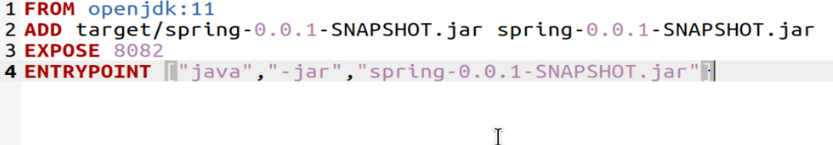
Docker File
Dockerfile is a text document that contains all the commands to assemble an image
Docker can build images automatically by reading the instructions from a Dockerfile.

Slide 16
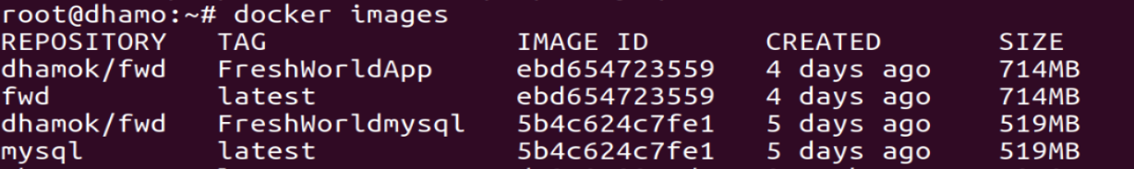
Docker Image
An image is a read-only template with instructions for creating a Docker container.
It consists of application code, libraries, tools, dependencies, etc.
A docker image is described in text file called a Dockerfile,

Slide 17
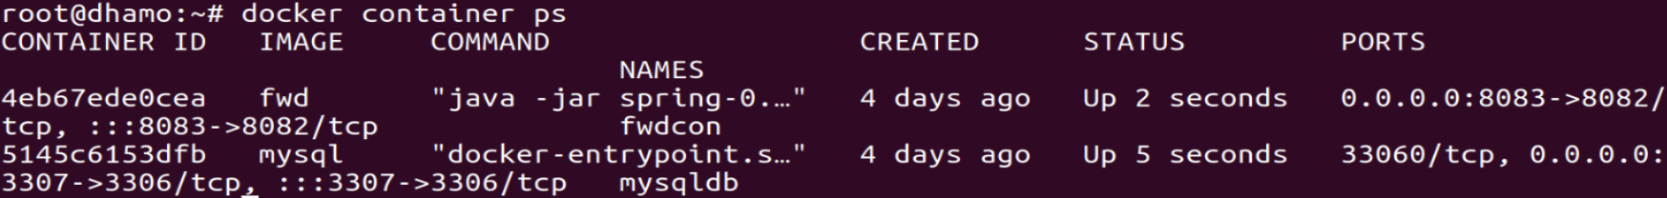
Docker container
Docker container is a running instance of an image.
Its main benefit is to package applications in containers.

Slide 18
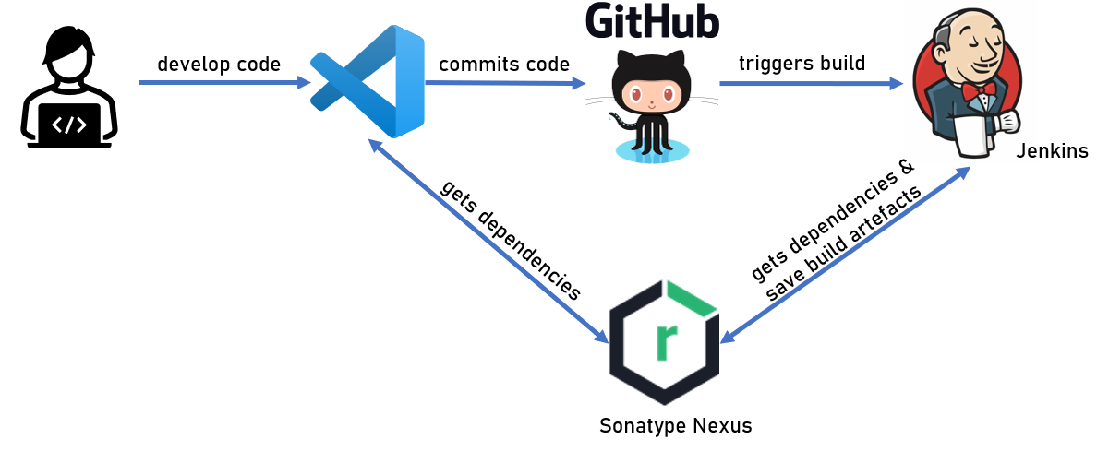
Jenkins
Jenkins is an open source automation server.
It helps automate the parts of software development related to building, testing, and deploying, facilitating continuous integration and continuous delivery.

Slide 19
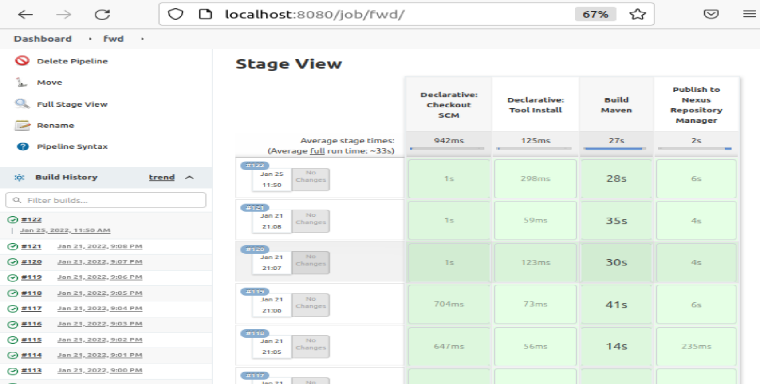
Jenkins Pipeline

Slide 20
Nexus
Nexus is a repository manager.
It allows you to proxy, collect, and manage your dependencies
It supports many artifact formats, including Docker, Java, and npm.
It makes easy to distribute your software

Slide 21
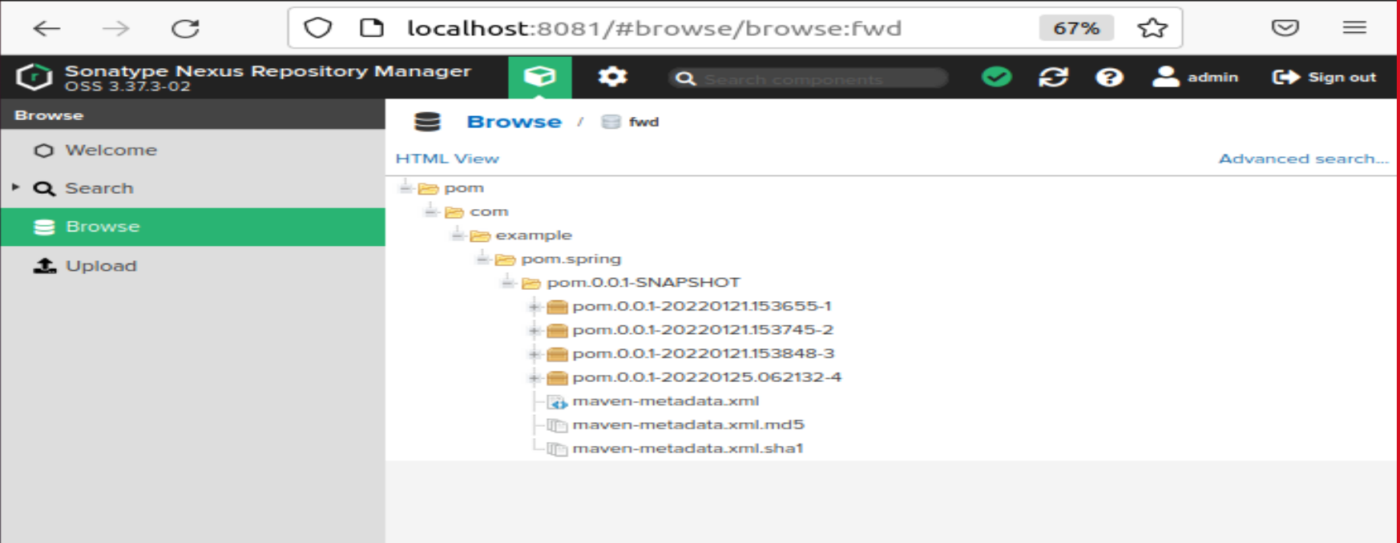
Nexus Repository

Slide 22
Thank you

